Slide 1

Breast Cancer Prediction using Deep Learning Techniques Batch: 2020_CSE_02 Phase – 1 Review Presentation Project Work Phase II + Seminar (17CSP78)
Under the guidance of: Presented by:
Prof. Aditya Pai H
Assistant Professor Rohith K 1KS17CS062
Department of CSE Shri Harsha Kulkarni 1KS17CS077
K S Institution of technology Rakshith R 1KS17CS061

Slide 2
CONTENTS
Introduction
Problem Identification
Goals and Objectives
Literature Survey
Methodology
Expected Outcomes
References

Slide 3
INTRODUCTION
Breast cancer is a malignant tumor that starts in cells of the breast. A malignant tumor is a group of cancer cells that spread into distant areas of the body.
Breast Cancer, one of the commonest malignancies, is a major cause of death among women in developed countries like UK, USA and in developing countries like India.
Sometimes an abnormal situation occurs, where a few cells may start growing abnormally. This abnormal growth of cells creates cancer, which can start from any part of the body and be distributed to any other part.
Different types of cancer can be formed in human body; among them breast cancer creates a serious health concern.

Slide 4
PROBLEM IDENTIFICATION
With the growth of developing countries grows the risk of suffering from diseases like breast cancer among its people.
An analysis has shown that survival rate is 88% after 5 years of diagnosis and 80% after 10 years of diagnosis.
Earlier detection of breast cancer reduces death rate and avoids it till reaches the chronic level.
The impact of breast cancer is increasing day by day, due to that the healthcare professionals are not in a condition to state the people affected at different stages earlier to save their lives.

Slide 5
GOALS AND OBJECTIVES
The Main objective of the project is to develop predictive model to identify the type of breast cancer as benign or malignant.
To design a system which helps oncologist in diagnosing the cancer type with in no time and then helps oncologist in decision making in treatment method for the same purpose.

Slide 6
LITERATURE SURVEY
Titles of the Paper with Authors | Year and Place of Publication | Methodology Used | Merits | Demerits
“Deep learning based breast cancer detection and classification using fuzzy merging techniques” by R. Krithiga and P. Geetha | August 2020, Springer, Chennai, India | The proposed method provides an automatic system for nuclei detection and classification from H&E-stained images. which includes several steps such as biomedical data preprocessing, nuclei detection, segmentation, feature extraction, and classification. | This paper has proposed a fast and refined cancer nuclei region detection. The classification framework in H&E stained breast cancer images classifies cancer into two classes of lesions, benign and malignant | Accuracy level is not 100% accurate it is around 98.62%
"Methods Used in Computer-Aided Diagnosis for Breast Cancer Detection Using Mammograms: A Review” by Saleem Z. Ramadan | Journal of Healthcare Engineering, Volume 2020 | The methodology used - feature extraction, feature selection, and classification methodologies. | This method explains about the breast cancer detection and diagnosis using mammograms. | The mammograms is limited by the low contrast between normal glandular breast tissues and malignant ones and between the cancerous lesions and the background, especially in dense breasts tissue.

Slide 7
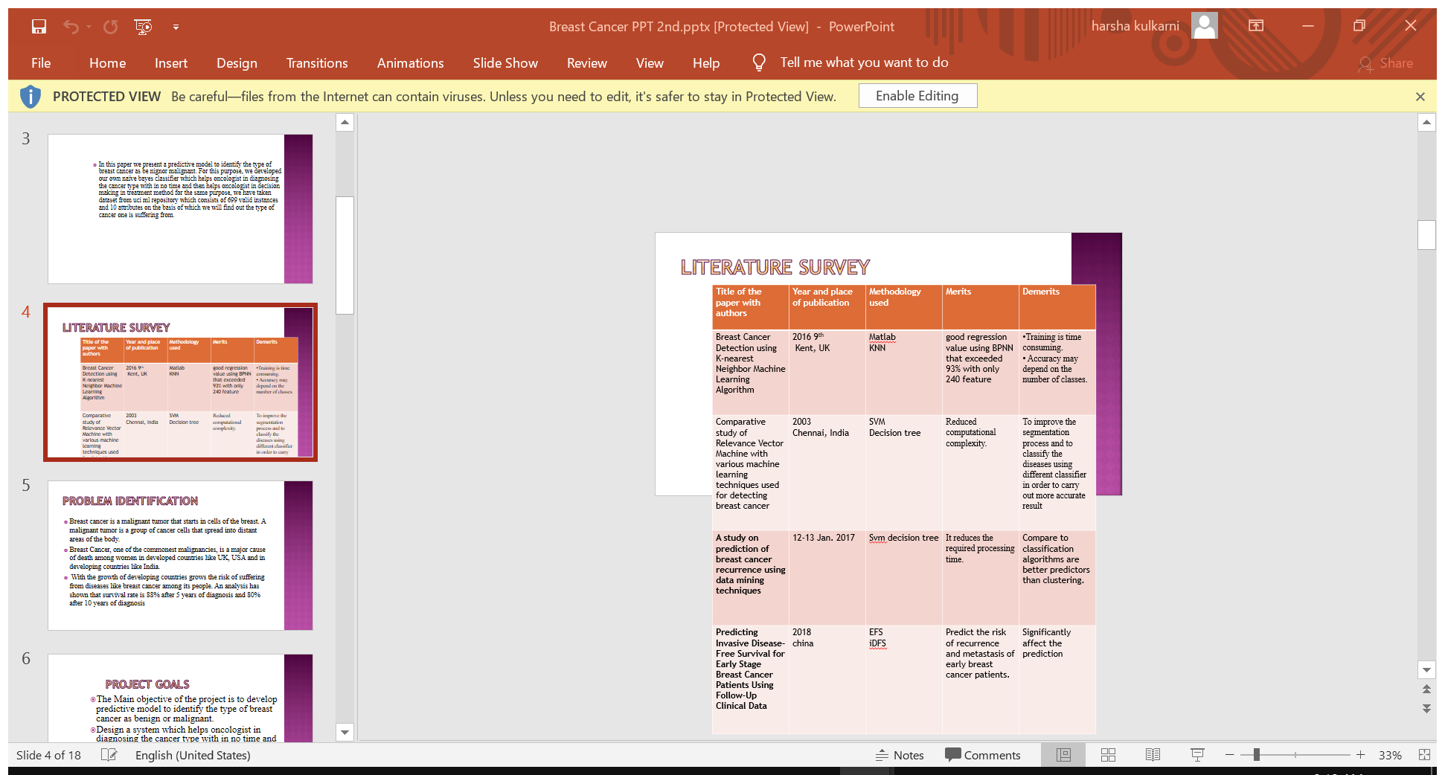
LITERATURE SURVEY

Slide 8
METHODOLOGY
The Process includes the detection of breast cancer using MR image analysis that are broadly divided.
Study of preprocessing of MR images. Image acquisition
Adaptive filtering
Study of Image Analysis of MR images Segmentation
Feature Extraction
Enhancement
Development of machine learning algorithms DNN for breast Cancer Prediction using Machine Learning Techniques

Slide 9
Preprocessing: Preprocessing is needed as it provides improvement in image data which enhances some of the image features which are important for further processing.
The pre-processing steps that are applied to MR image are as follows :
The RGB MR image is converted to gray scale image and then median filter is applied for noise removal from breast cancer MR images.
The noise is to removed for further processing as high accuracy is needed.
Then edges are detected from filtered image using canny edge detection.
The edge detected image is needed for segmentation of the image. Then watershed segmentation is done for finding the location of the tumor in the breast image .
Segmentation is the process of dividing an image into multiple segments.

Slide 10
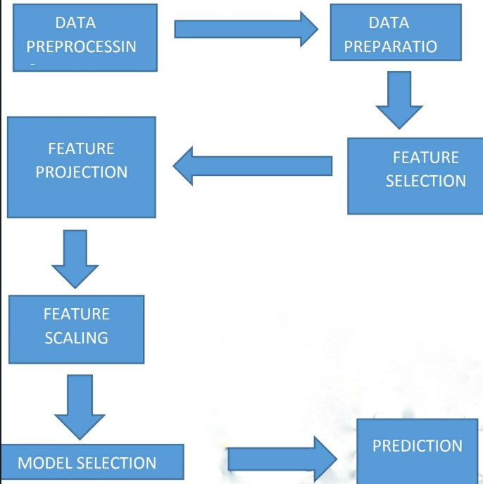

Slide 11
EXCEPTED OUTCOMES
Training of cancer Images .
Detect the breast cancer using CNN.
Intimation and remedies.

Slide 12
CONTRIBUTION TO THE SOCIETY
In this work, different methods and solutions for automatic detection of breast cancer in histopathology images have been investigated. The aim of this work is to develop a high accuracy method that can detect cancer at early stages, define the exact type of the samples, and improve previous works results.
The nature of cancer is often evolving, so a new dataset will not yield good results based on a collection of local features. However, due to Global Feature extraction capabilities of Deep Neural Networks, particularly CNN, have recently advanced biomedical image classification.

Slide 13
REFERENCES
R. Krithiga and P. Geetha, "Deep learning based breast cancer detection and classification using fuzzy merging techniques", Machine Vision and Applications (2020) Vol. 31 (63).
Saleem Z. Ramadan, "Methods Used in Computer-Aided Diagnosis for Breast Cancer Detection Using Mammograms: A Review", Journal of Healthcare Engineering, Volume 2020
S. Karthik, R. Srinivasa Perumal and P. V. S. S. R. Chandra Mouli
Breast Cancer (http://www.cancer.gov /cancertopics/types/breast)
Ian H. Witten and Eibe Frank. Data Mining: Practical machine learning tools and techniques, 2nd Edition. San Fransisco: Morgan Kaufmann; 2009..
Breast Cancer dataset. http://archive.ics.uci edu/ml /datasets /Breast+ Cancer +Wisconsin +%28Original.
Weka( http://weka. sourceforge.net /doc/ weka/ classifiers)
Naïve Bayes Classifier.www.statsoft.com /textbook/naïve bayes –classifier
Deep Learning Applied for Histological Diagnosis of Breast Cancer; YASIN YARI , THUY V. NGUYEN , AND HIEU T. NGUYEN

Slide 14
THANK YOU !

